Slide 1
Mid-Term Project
2D Graphics Pipeline
Megh Vankawala (CWID: 10421684)

Slide 2
Overview
In this project I have implemented 2d- graphics pipeline.
First, I have implemented Scanline Polygon fill algorithm for polyfon filling
After that I have implemented Sutherland-Hodgman Polygon
Clipper for Clipping.
Then I have added different 2D- Transformations(i.e Translation, Rotation, Scaling).
I have also set clipwindow and Viewport.
In midterm.java file, I have put different inputs to run this Project.
I have selected 700*700 output window.

Slide 3
Midterm.java file
In this project I have set 5 mouse click to run different outputs.
Initially I have added 4 Tringle,4 Square and letter “MEGH” with different colors using scanline polygon fill algorithm.

Slide 4
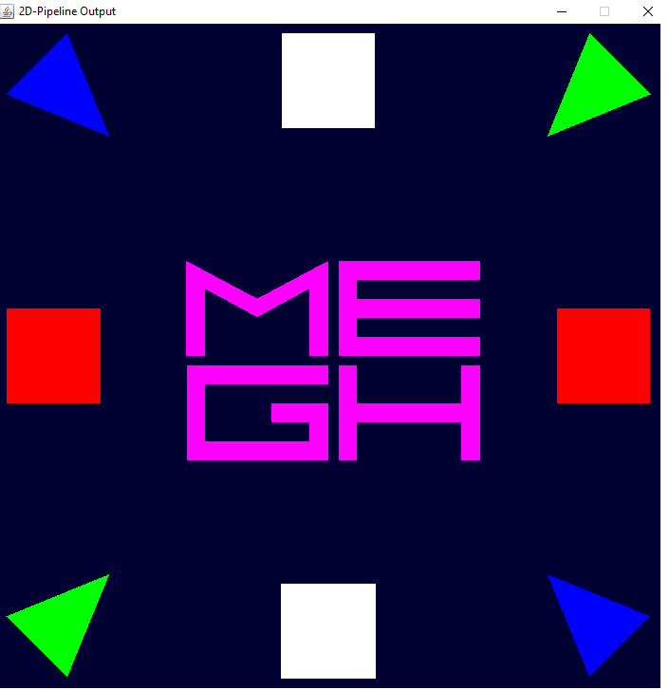

Slide 5
Midterm.java file
Here, I have applied different transformation on this polygons.
For e.g , All tringles will translate to central point of the window.
All squares will first rotating and then translating.
I have scaled Letter “MEGH” and then translate each letter to different corners.
In every click except last, I have set default clipwindow and viewport.
After 1st and 3rd click ,all these transformations will perform.
On 4th click I have applied some fun logic and make replicas.

Slide 6
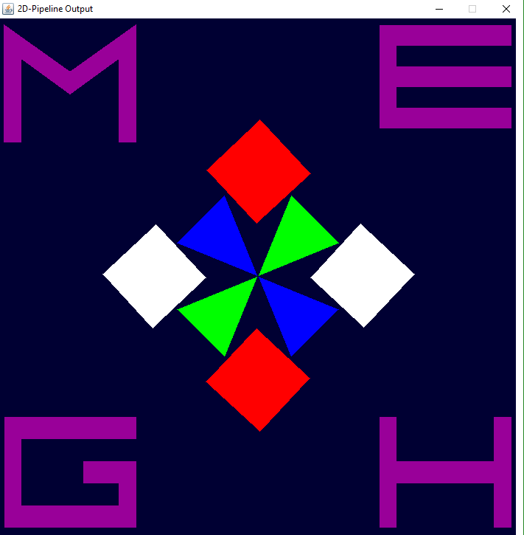

Slide 7
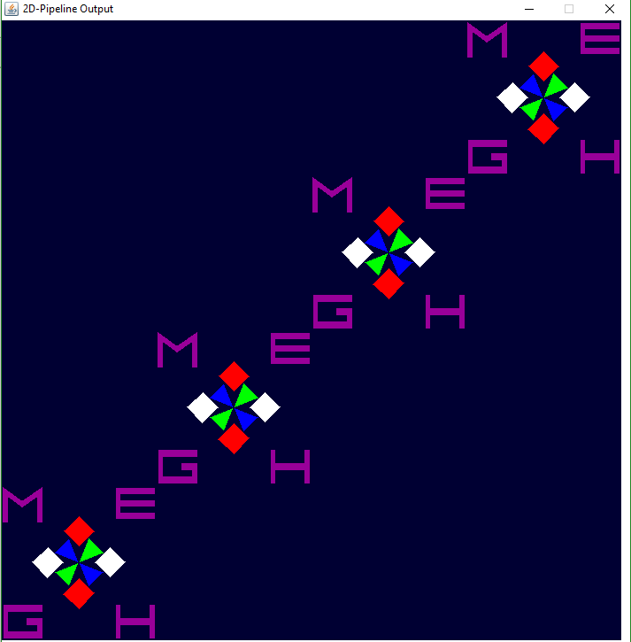

Slide 8
Midterm.java file
On last click I have changed clipwindow dimension to
C.Clipwindow( 250.0f, 500.0f, 250.0f, 500.0f );
Default clipwindow [ C.Clipwindow( 0.0f, 700.0f,0.0f, 700.0f );]

Slide 9
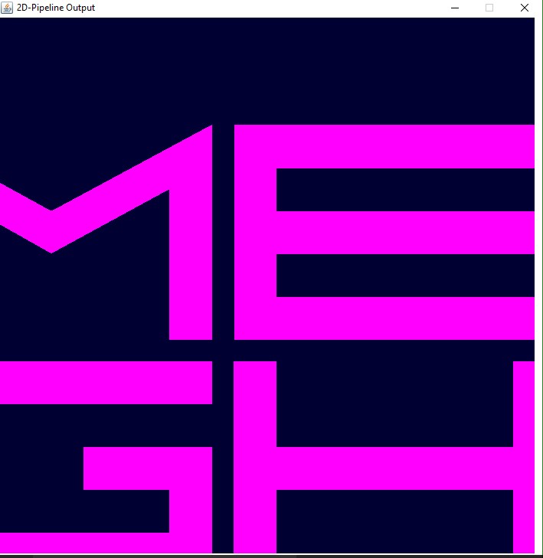

Slide 10
Thank You

